Slide 1
Dictionaries & Manipulating string

Slide 2



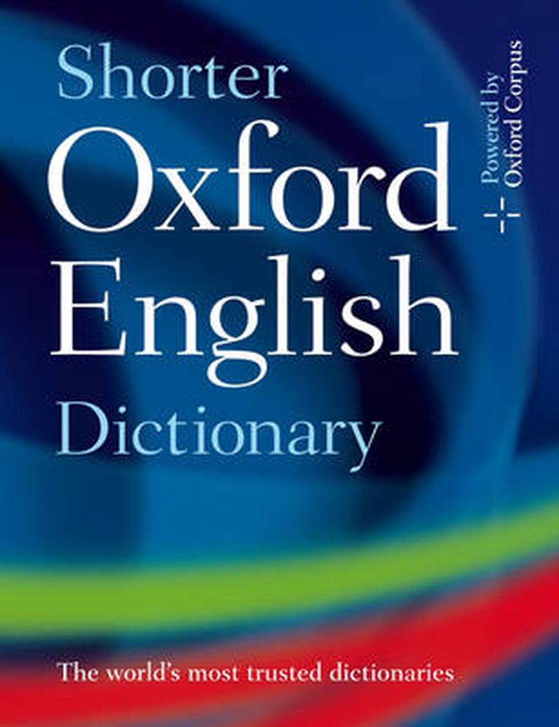

Dictionaries String Manipulation
THE BETA LIST
THE CHAD DICTIONARY
Does not need to rely on indexes
Needs order to be structured
Starts with a 0
Gets upset when the index is out of range
Always brings a key/value pair to the party
Is structured without needing order
Has lots of value(s)

Slide 3

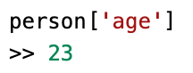
Dictionaries
Dictionaries are mutable collections of many values.
Dictionaries are typed with braces, {}
You can access values in a dictionary through their keys:
Key 1
Value 1
Key 2
Value 2
Variable
Key-value pair 1
Key-value pair 2

Slide 4
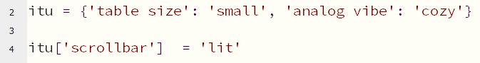
Adding new key/value pairs
Variable containing dictionary
variable name
New key
New value

Slide 5
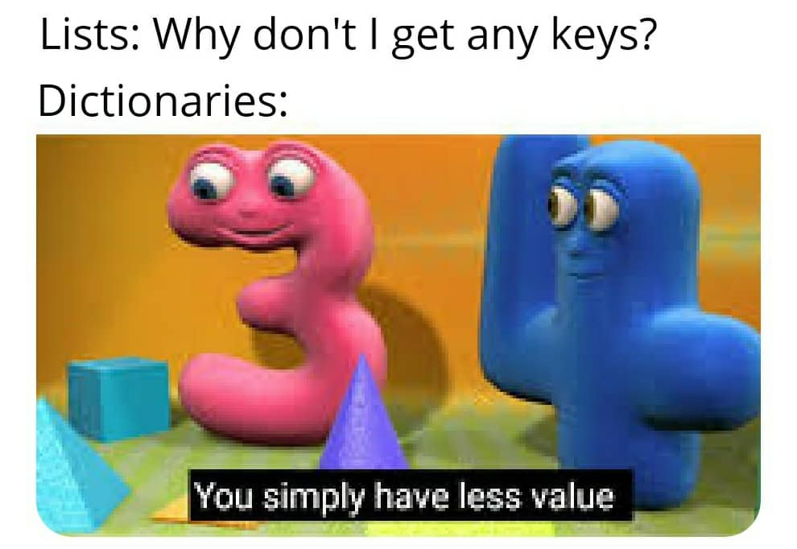
Dictionaries
Are unordered
Can't be sliced
Use keys to access values
Lists
Are ordered
Can be sliced
Use indexes to access values

Slide 6
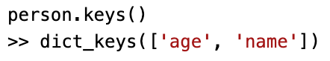
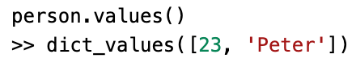
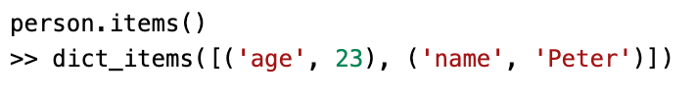
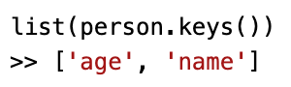
Dictionary Methods
keys() method – returns list like values of the dictionary's keys
values() method – returns list like values of the dictionary's values
items() method – returns list like values of the dictionary's keys and values
The list() function – if you want your return value to be a list, you can use this function.
Notes:
The keys(), values() and item() methods does not return true lists as these cannot be modified – however they can (and are used) in for loops.

Slide 7
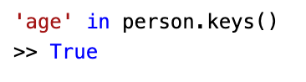
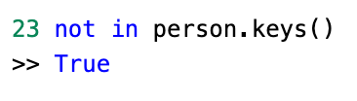
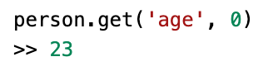
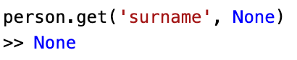
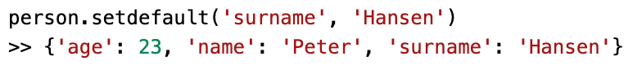
in or not in operators – like with lists, these operators can be used to check whether a value exists as a key, a value or both.
get() method – takes two arguments: the key of the value and a fallback value. The method returns the value assosiated with the wished key. If the key does not exist in the dictionary, the fallback value is returned.
setdefault() method – is used to set a value for a certain key, if that key does not already exist.

Slide 8
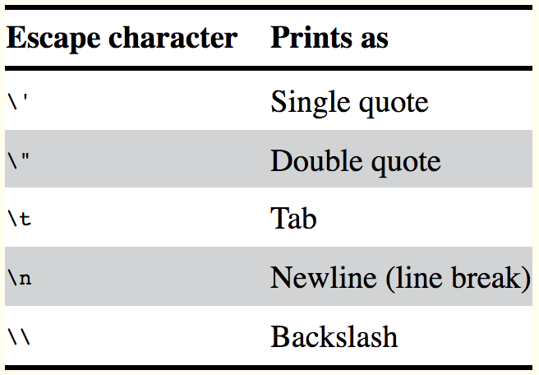
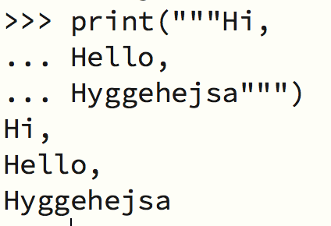
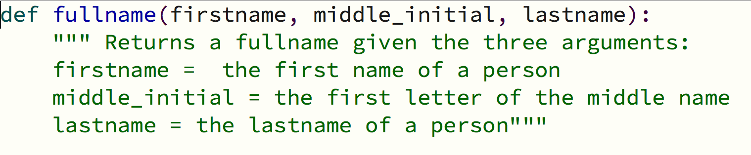
String Literals
Escape Characters: Lets you use characters that are otherwise impossible to put into a string
Raw strings: A raw string completely ignores all escape characters and prints any backslash that appears in the string.
Multiline Strings: Can be created by using triple quotes """ """
Multiline Comments: Used when writing comments (not code) that span multiple lines

Slide 9

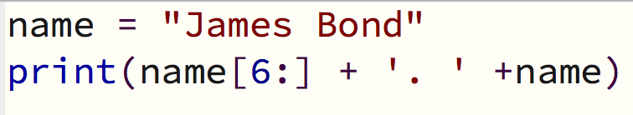
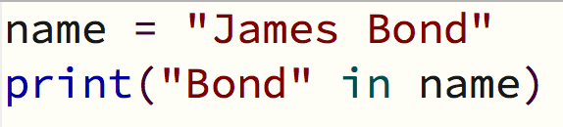
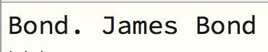
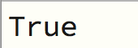
Indexing and slicing strings
The in and not in operator
Strings uses indexes and slices like lists do
A string can be sliced by using the index. The first character of the string will be index 0.
The in and not in operators can also be used with string values just like lists
Will evaluate to a boleean value True or False

Slide 10
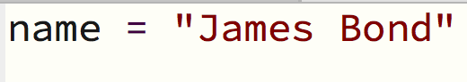
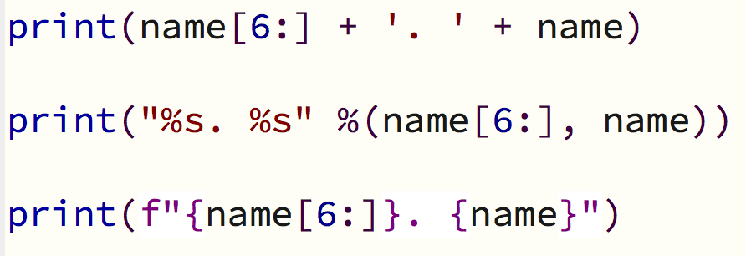
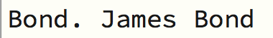
Putting strings inside other strings
String Concatenation: Using the + operator
String Interpolation: Using the %s operator inside the string to act as a marker to be replaced by the values following the string
f-strings: Using the f prefix before the starting quotation mark and braces { } around the expressions

Slide 11
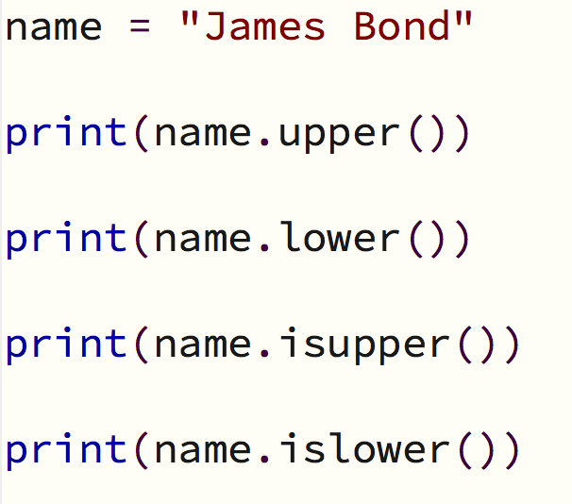
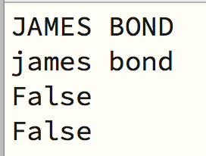
Other useful string methods
upper(): returns a new string where all the letters have been converted to uppercase
lower(): returns a new string where all the letters have been converted to lowercase
Remember that upper() and lower() do not change the string itself but return new string values. To change the original string, you need to assign it to the variable where the string is stored.
isupper(): Returns True if the string has at least one letter and the letters are uppercase and False otherwise
islower(): Returns True if the string has at least one letter and the letters are lowercase and False otherwise

Slide 12
The isX() methods
isalpha(): Returns True if string consists only of letters and isn't blank
isalnum(): Returns True if the string consists only of letters and numbers and is not blank
isdecimal(): Returns True if the string consists only of numeric characters and is not blank
isspace(): Returns True if the string consists only of spaces, tabs, and newlines and is not blank
istitle(): Returns True if the string consists only of words that begin with an uppercase letter followed by only lowercase letters

Slide 13
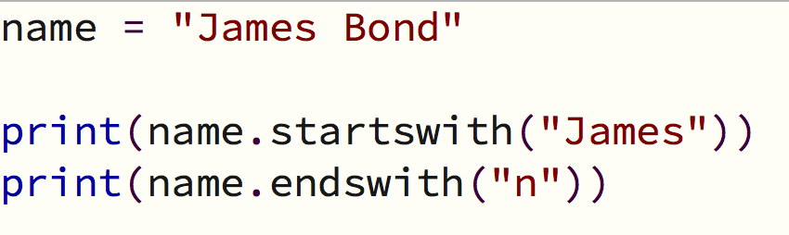
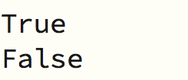
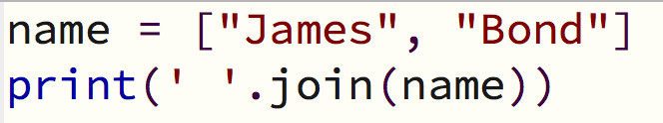
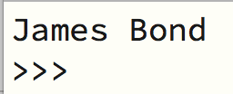
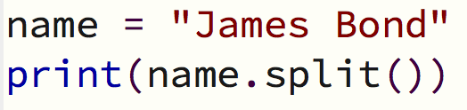
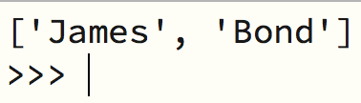
More useful methods
startswith() and endswith()
Return True if the string value they are called on begins or ends with the string passed to the method
Return False otherwise
join() and split()
join(): Joins a list of strings into one string
Is called on a string, gets passed a list of strings and returns a string
The string that the method calls on is inserted between each string in the list.
split(): Splits a string into a list of strings
Is called on a string and returns a list
By default, the method will split at whitespace characters (space, tab or newline)
Can be passed a string to specify a different string to split upon

Slide 14
Methods
partition('seperator'): split a string into the text before and after a seperator string. Returns tuple of three strings: the 'before', the seperator and the 'after'
rjust(): returns the string with spaces inserted before to justify the text to the right
ljust(): returns the string with spaces inserted after to justify the text to the left
center(): returns the string with spaces inserted before and after to justify the text in the center
The argument for the methods is an integer specifying the total length of the string
The optional argument: a second argument can specify a character other than a space character to justify the string

Slide 15
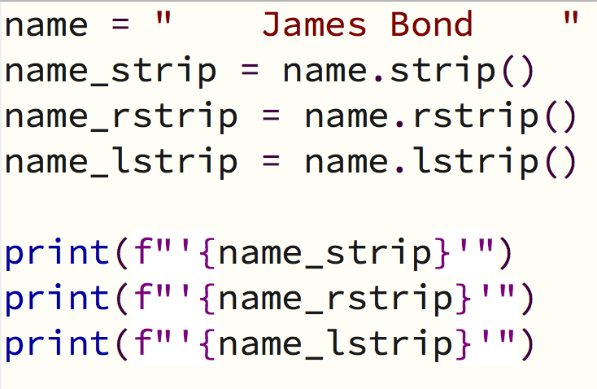
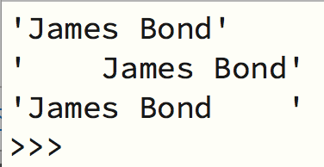
Methods
strip(): removes whitespace characters (space, tab, newline) in the beginning and the end of the string
rstrip(): removes whitespace characters (space, tab, newline) in the end of the string
lstrip(): removes whitespace characters (space, tab, newline) in the beginning of the string
Optional argument: a string can be passed to the method to specify what characters should be removed from the beginning and/or the end of the string

